Slide 1


Source: https://www.neumetric.com/network-intrusion-detection-system/
Master Colloquium - B
Project Title: “Detecting and Investigating Network Intrusions with NSL-KDD Dataset”
Group-D :
Md Ashraful Hakim Khan Siddiquee
Prof. Dr. Ing. Marcus Purat
17/7/2024

Slide 2

Outline
Introduction
Problem Statement
Objectives of our research
Methodology
Implementation
Experimental result and Analysis
Conclusion
References

Slide 3
Introduction
Context:
Network security is crucial in today's interconnected world.
Intrusion Detection Systems (IDS) help protect against unauthorized access.
Motivation:
Detecting intrusions is essential to prevent data breaches and cyber-attacks.
The NSL-KDD dataset is widely used for benchmarking IDS.

Slide 4

Network Intrusion Detection System (NIDS)
What is Network Intrusion Detection System (NIDS)?
A Network Intrusion Detection System (NIDS) monitors network traffic for suspicious activity and alerts the system or network administrator. It's an essential component of network security, helping to identify and mitigate threats such as unauthorized access, malware, and denial-of-service attacks.
Why is NIDS important?
With the increasing complexity and frequency of cyber attacks, having a robust NIDS is critical for protecting network infrastructure and sensitive data. NIDS can help detect intrusions in real-time, allowing for quick responses to potential threats.

Slide 5
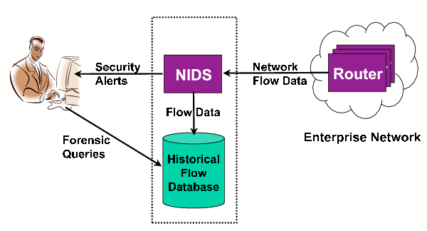
Network Intrusion Detection System (NIDS)

Slide 6
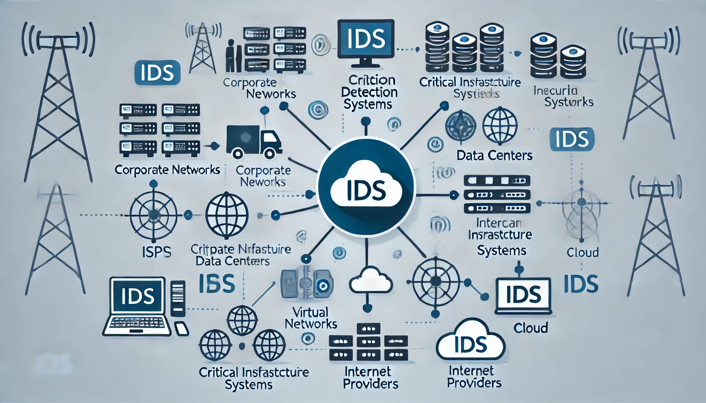
Where is it used?

Slide 7
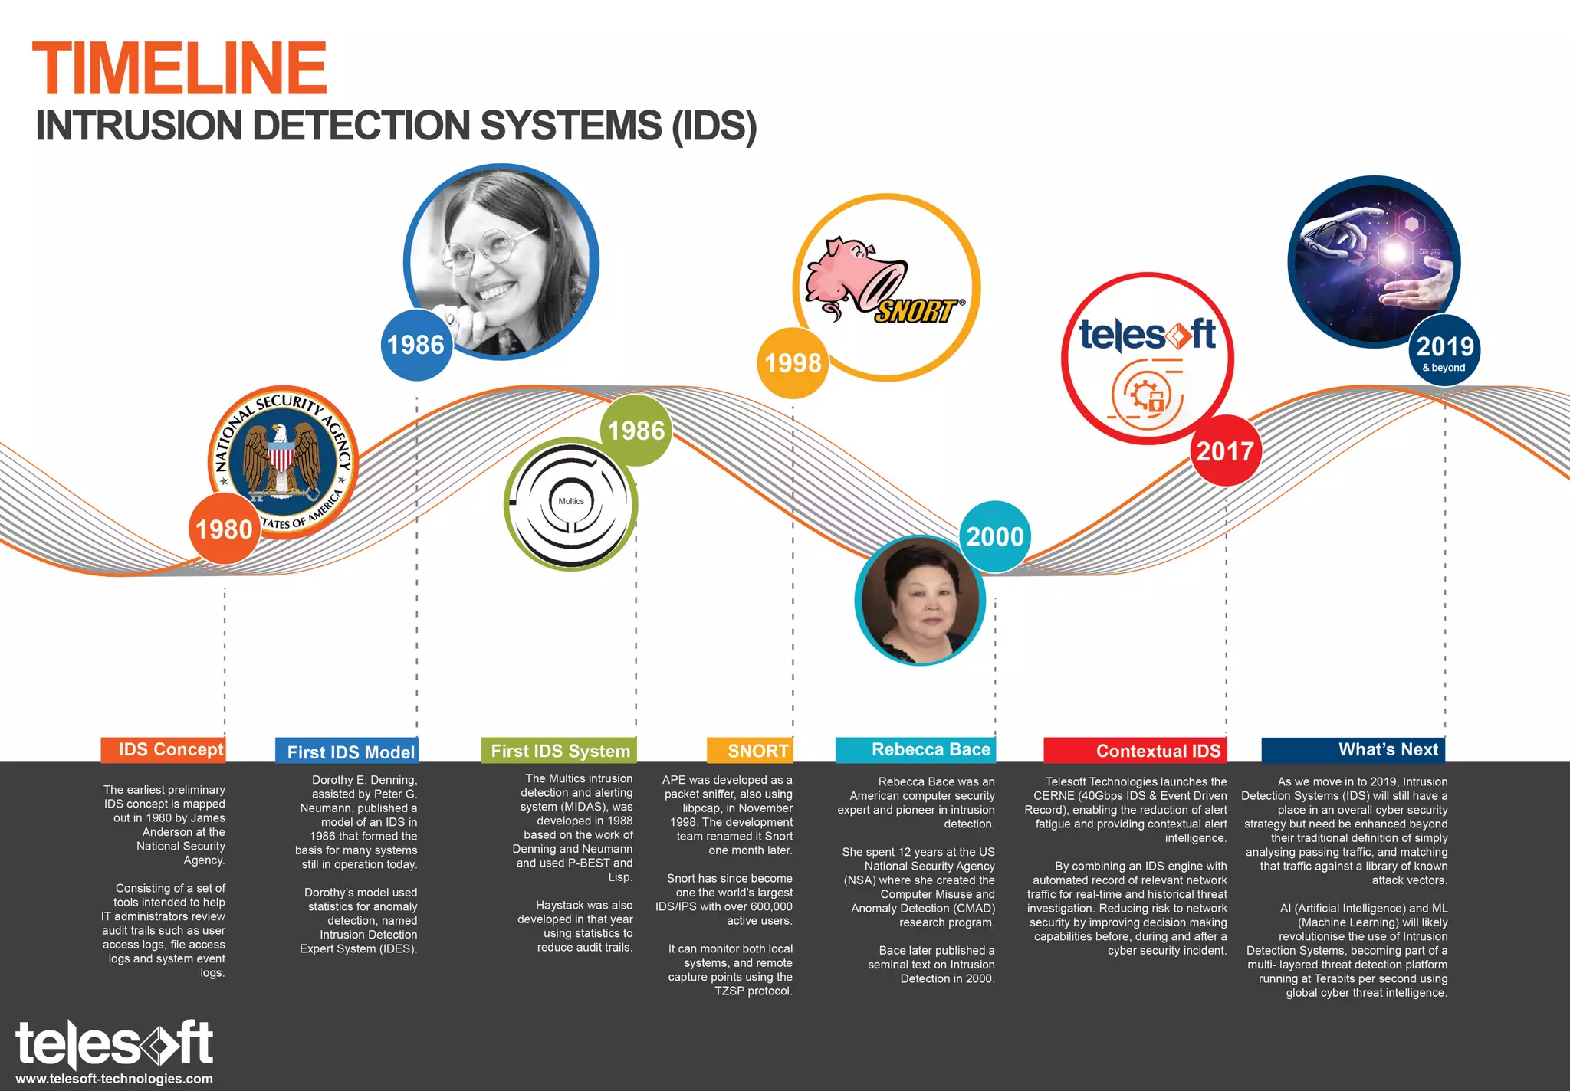
History of Intrusion Detection Systems (IDS):

Slide 8
NSL-KDD Dataset
The NSL-KDD dataset, developed by the Canadian Institute for Cybersecurity at the University of New Brunswick, improves upon the KDD'99 dataset by removing redundant records, ensuring no duplicate records in the test set, and balancing record distribution by difficulty. It includes files in ARFF (Attribute-Relation File Format) and CSV (Comma-Separated Values) formats for training and testing machine learning models. Despite some remaining limitations, it still can be applied as an effective benchmark data set to help researchers compare different intrusion detection methods due to the lack of public datasets in this field.

Slide 9
Increasing Cyber-Attacks:
The frequency and sophistication of cyber-attacks are escalating, making network security a critical concern.
Limitations of Traditional IDS:
Traditional Intrusion Detection Systems (IDS) often struggle with adaptability and efficiency, especially in handling large volumes of data and novel attack types.
Problem
Statement
Need for Enhanced Detection:
There is a pressing need for more effective IDS that can accurately detect both known and unknown intrusions with minimal false positives.

Slide 10
Objective of our research
The primary objective of this project is to Detecting and Investigating Network Intrusions with NSL-KDD Dataset and develop a robust machine learning-based Intrusion Detection System (IDS).
project involves training and comparing the performance of three different machine learning algorithms—Logistic Regression, Random Forest, and Support Vector Machine (SVM)—to identify the most effective model for intrusion
This IDS aims to accurately classify network traffic as either benign or malicious, thereby enhancing network security and preventing potential cyber-attacks.

Slide 11
Technical / Theoretical Approaches in Intrusion Detection Systems (IDS)
01
02
Signature-Based Detection
02
Anomaly-Based Detection
03
04
Machine Learning-Based Approaches
Hybrid Approaches

Slide 12
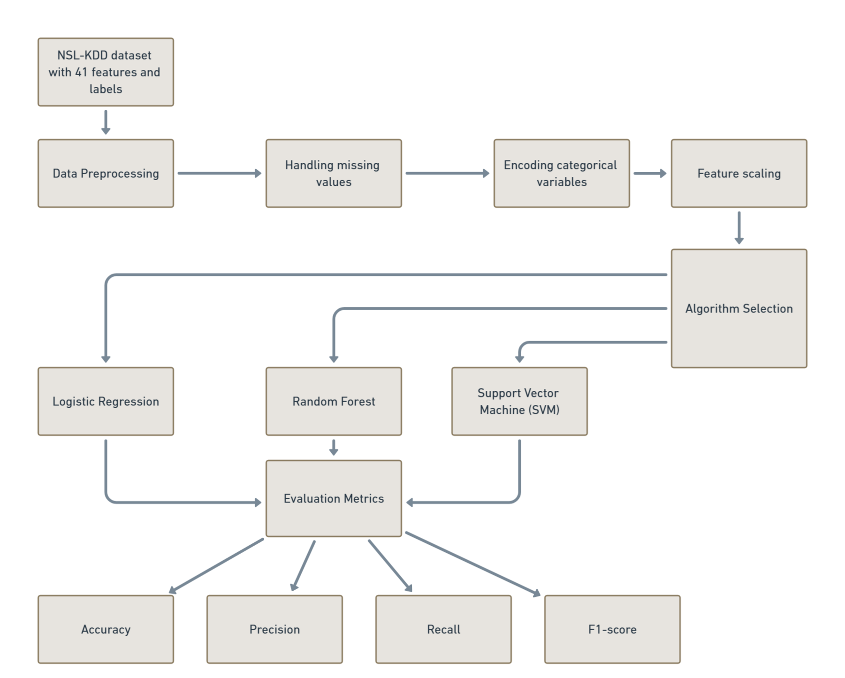
Methodology
NSL-KDD Dataset

Slide 13
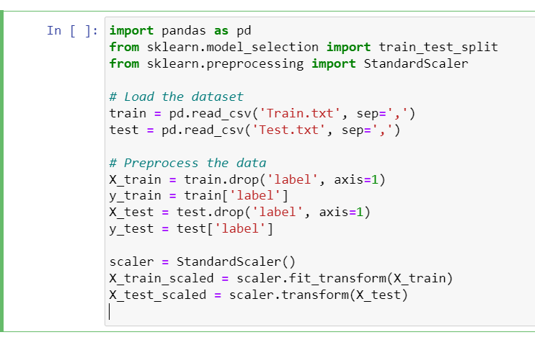
Implementation

Slide 14
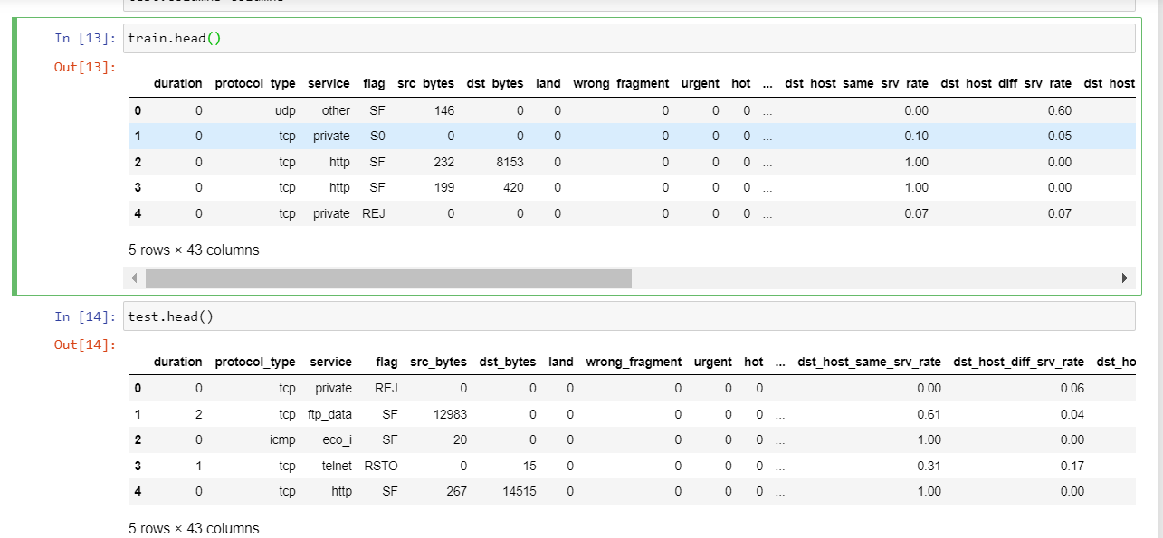
Implementation

Slide 15
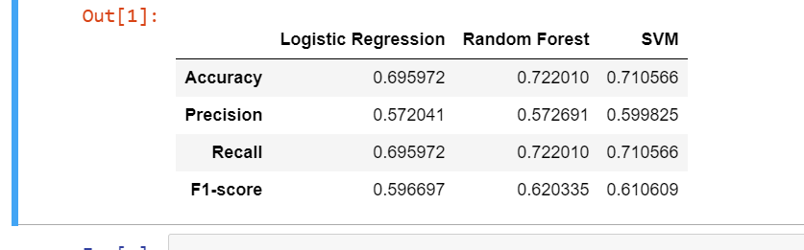
Results and Analysis
Logistic Regression:
Accuracy: 0.695972
Precision: 0.572041
Recall: 0.695972
F1-score: 0.596697
Random Forest:
Accuracy: 0.722010
Precision: 0.572691
Recall: 0.722010
F1-score: 0.620335
SVM:
Accuracy: 0.710566
Precision: 0.599825
Recall: 0.710566
F1-score: 0.610609

Slide 16
Summary of Results:
Random Forest outperformed both Logistic Regression and SVM in all metrics, indicating it was the most effective model for this dataset.
SVM showed better precision compared to Logistic Regression, suggesting it made fewer false positive errors.
Logistic Regression had the lowest performance among the three models but still provided reasonable metrics.

Slide 17
Conclusion
Future Work:
Explore more algorithms like neural networks.
Improve feature selection and engineering.
Apply the models to other datasets for generalization

Slide 18

References:
Neumetric. (n.d.). Network Intrusion Detection System. Retrieved from https://www.neumetric.com/network-intrusion-detection-system/
W Learning Education. (2017, May). What is IDS, NIDS - Network Security. Retrieved from https://w-learningeducation.blogspot.com/2017/05/what-is-ids-nids-network-security.html
Canadian Institute for Cybersecurity, University of New Brunswick. (n.d.). NSL-KDD Dataset. Retrieved from https://www.unb.ca/cic/datasets/nsl.html
Tavallaee, M., Bagheri, E., Lu, W., & Ghorbani, A. A. (2009). A detailed analysis of the KDD CUP 99 data set. Proceedings of the Second IEEE Symposium on Computational Intelligence for Security and Defence Applications (CISDA 2009). Retrieved from https://www.unb.ca/cic/datasets/nsl.html
Susilo, B., & Sari, R. F. (2020). Intrusion Detection in IoT Networks Using Deep Learning Algorithm. Information, 11(5), 279. https://doi.org/10.3390/info11050279
Buczak, A. L., & Guven, E. (2016). A Survey of Data Mining and Machine Learning Methods for Cyber Security Intrusion Detection. IEEE Communications Surveys & Tutorials, 18(2), 1153-1176. doi:10.1109/COMST.2015.2494502
Sommer, R., & Paxson, V. (2010). Outside the Closed World: On Using Machine Learning for Network Intrusion Detection. Proceedings of the 2010 IEEE Symposium on Security and Privacy. doi:10.1109/SP.2010.25
Collibra. (2022). Data Intelligence Cloud - Cloud Infrastructure. Retrieved from http://cdn.collibra.com.
Dfdf Devi, T. R., & Badugu, S. (2020). Chapter 69: A Review on Network Intrusion Detection System Using Machine Learning. In S. C. Satapathy et al. (Eds.), Advances in Decision Sciences, Image Processing, Security and Computer Vision (pp. 598-607). Springer. https://link.springer.com/chapter/10.1007/978-3-030-24318-0_69

Slide 19



